Slide 1
Converting Casual Riders to Annual Members Cyclistic Bike-Share (2023) October 2024

Slide 2
OBJECTIVE
Identify if there are vehicle, seasonal, chronological and/or geographical factors that contribute to the conversion of casual riders to annual members.

Slide 3
ANALYTICAL GOALS
Determine HOW casual riders and annual members use bikes differently.
Determine TOP recommendations based on the analysis.

Slide 4
ANALYTICAL GOALS
Determine HOW casual riders and annual members use bikes differently.
Determine TOP recommendations based on the analysis.

Slide 5
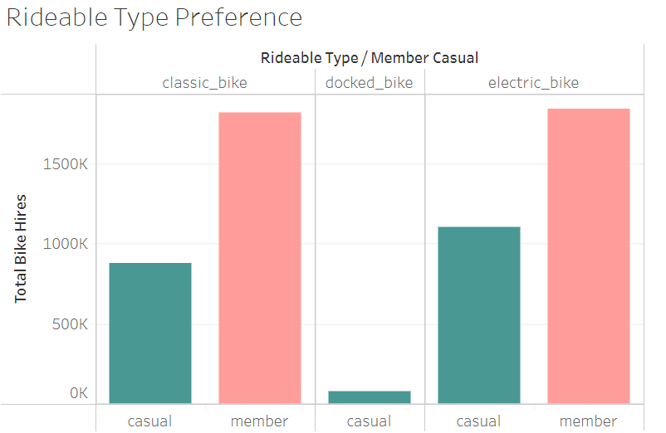
VEHICLE
Electric and Classic Bikes are Favorites
Total Bike Hires are high for Electric and Classic Bikes and very low for Docked Bike.
Annual Members don’t use Docked Bike.

Slide 6
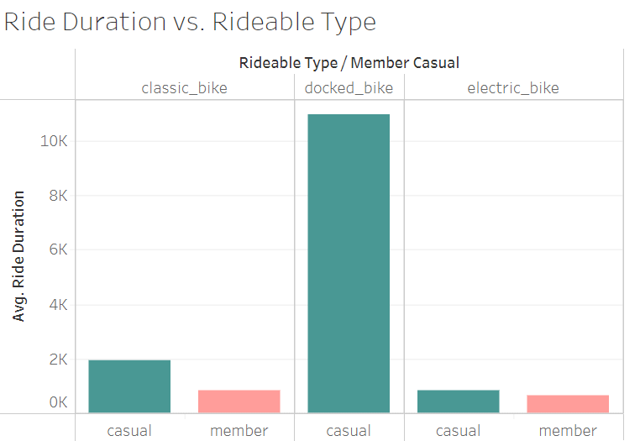
VEHICLE
Docked bike riders ride for the longest duration.

Slide 7
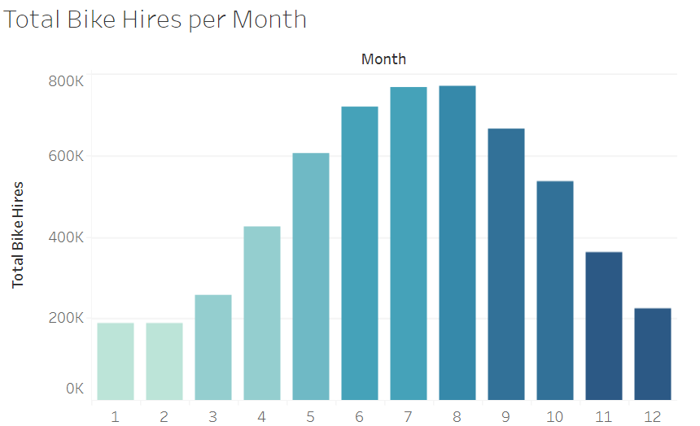
SEASONAL
Summer means Business
Total Bike Hires are high during summer and low during winter
JAN
FEB
MAR
APR
MAY
JUN
JUL
AUG
SEP
OCT
NOV
DEC
Source: Total bike hires over year 2023 = 5.74M

Slide 8
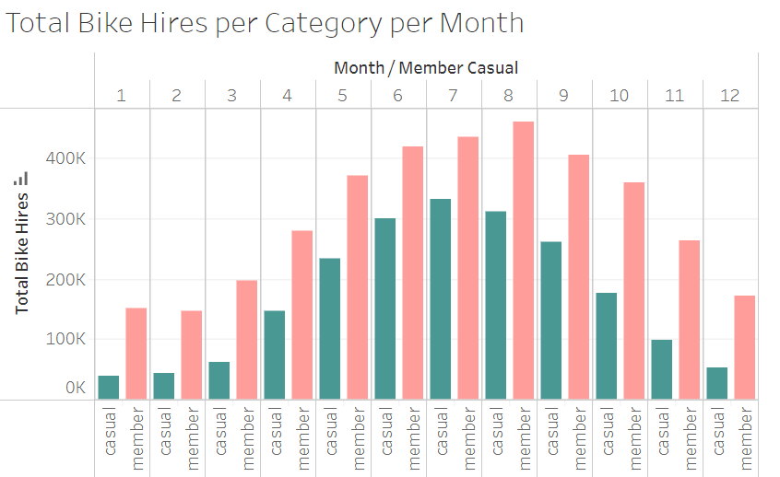
SEASONAL
JAN
FEB
MAR
APR
MAY
JUN
JUL
AUG
SEP
OCT
NOV
DEC
Huge Differences in Winter
Bike hires drop in winter, but members hire far more than casual users.

Slide 9
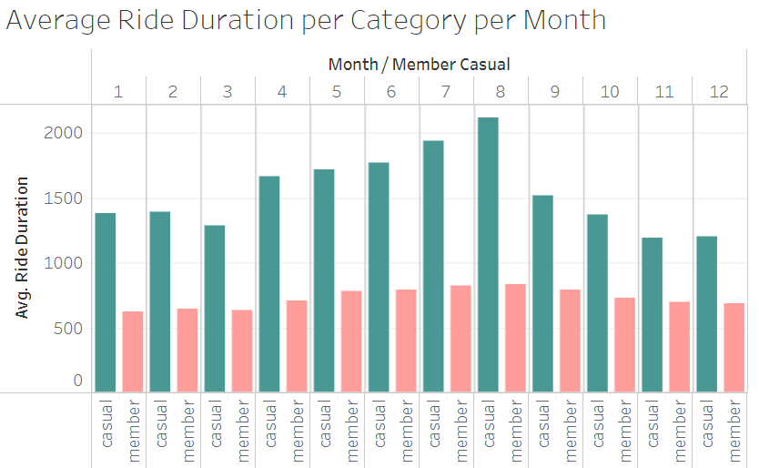
SEASONAL
Casuals ride longest
Throughout the year, casual riders maintain longer average ride times than members.

Slide 10
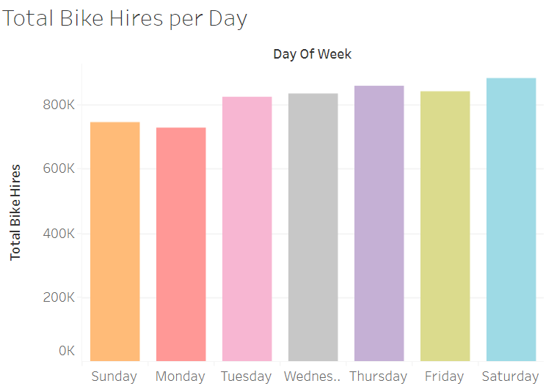
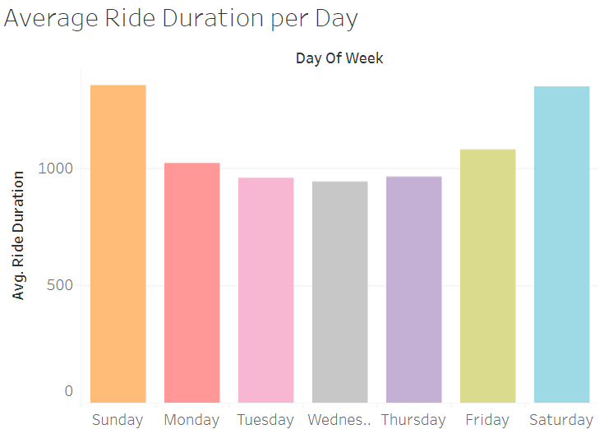
CHRONOLOGICAL
Riders love Weekends
Riders hire the most bikes on Saturdays.
Saturdays and Sundays have the longest average ride durations.

Slide 11
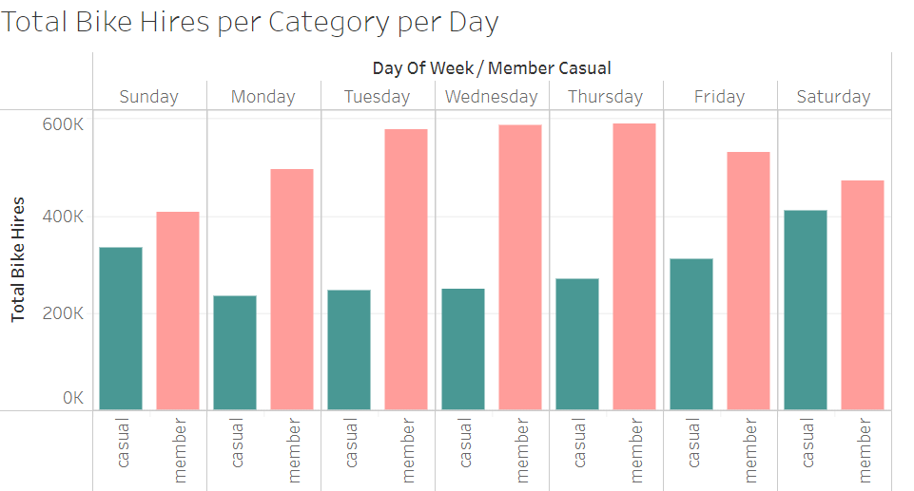
CHRONOLOGICAL
Fewer Differences on Weekends
On weekends, the difference between casual and member is small, with members slightly ahead.
On weekdays, the difference is huge, with members significantly ahead.

Slide 12
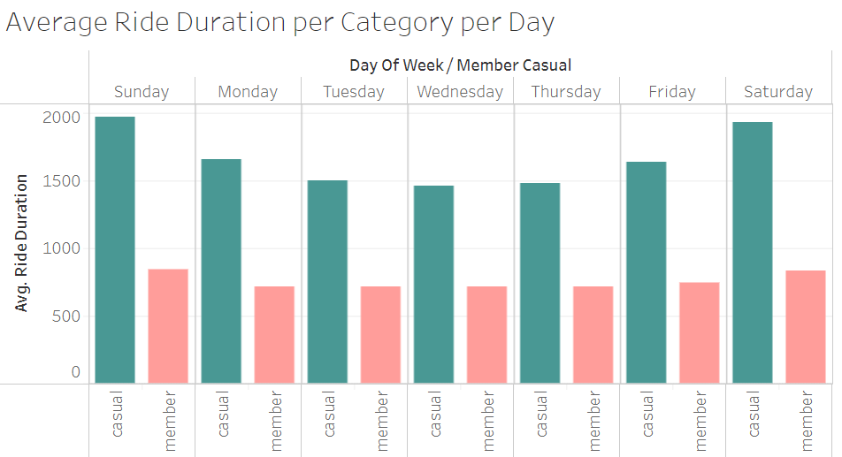
CHRONOLOGICAL
Casuals ride longest
Casual riders maintain longer average ride times than members, throughout the week and year.

Slide 13

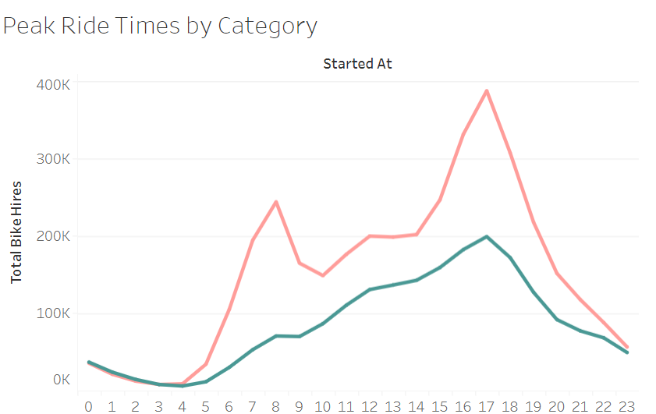
CHRONOLOGICAL
Peak ride hours
Peak ride times for members occur between 7 AM and 9 AM, and again from 4 PM to 6 PM.
Peak ride times for casuals starts from 8 AM and gradually increases until 6 PM.

Slide 14
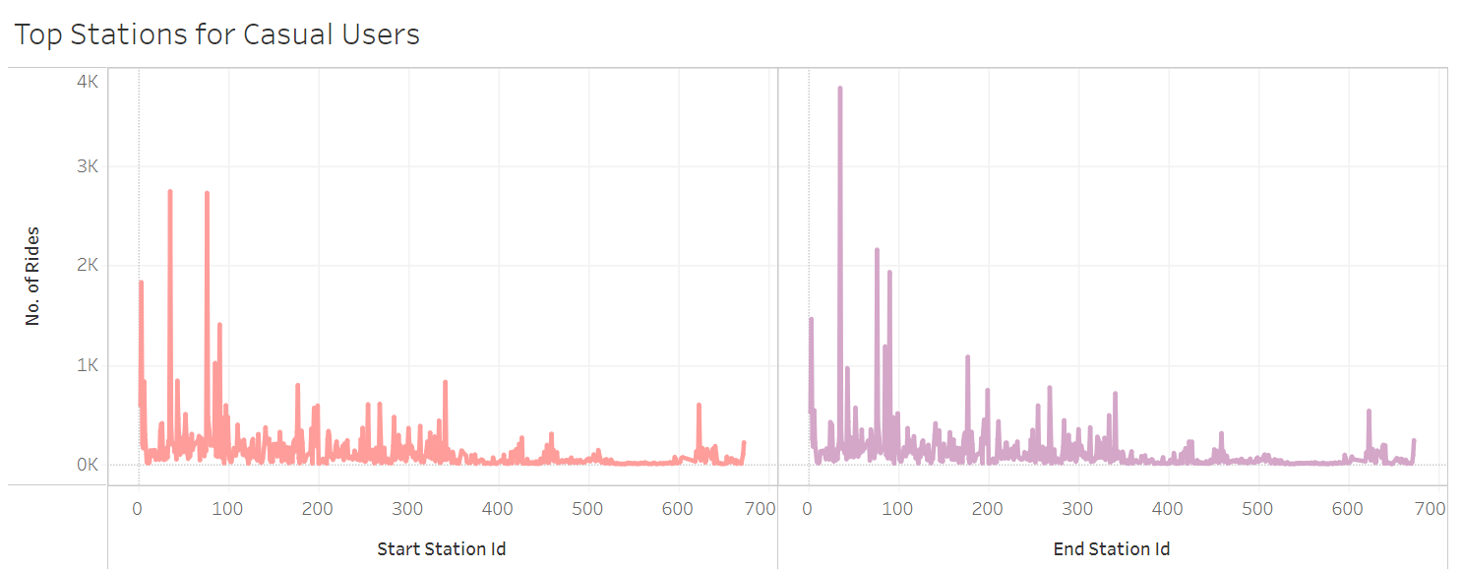
GEOGRAPHICAL
3 Shedd Aquarium
35 Streeter Dr & Grand Ave
76 Lake Shore Dr and Monroe St
90 Millenium Park
Popular locations
Most bike hires and drops occur at locations 3, 35, 76, and 90.

Slide 15
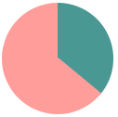
Total Bike Hires per Category
Many Casual Riders
Casual riders make up 36% of our total bike riders.
35.83%
64.17%
Source: Total bike hires per category (member = 3659987, casual = 2058621)

Slide 16
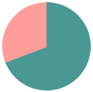
Avg. Ride Duration per Category
30.72%
69.28%
How Long do They Ride?
On average casual riders spend 69% more time on their bikes than member riders.
30.72%
69.28%
Source: Average Ride Duration per category (member = 751.7 secs, casual = 1695.2 secs)

Slide 17
ANALYTICAL GOALS
Determine HOW casual riders and annual members use bikes differently.
Determine TOP recommendations based on the analysis.

Slide 18
RECOMMENDATIONS
Show casual riders how they can save money by purchasing annual memberships as they ride longer.
Launch marketing campaigns aimed at casual riders during summer months.
Launch marketing campaigns aimed at casual riders during weekends.
Launch marketing campaigns aimed at casual riders in popular locations.
Run marketing campaigns on the most preferred type of bike.
Run marketing campaigns targeting casual riders during peak ride hours.

Slide 19
IN SUMMARY
HOW: Casual riders ride longer than members. They also have more rides on weekends that are almost equal to members. Ridership is seasonal.
RECOMMENDATIONS: Show casual riders why annual membership is better. Run campaigns just before and during weekends and summer months. Run campaigns at popular locations and peak ride hours.

Slide 20
Thank You

